Slide 1
Eventify - Jira
Event management and ticketing platform
Team 1

Slide 2
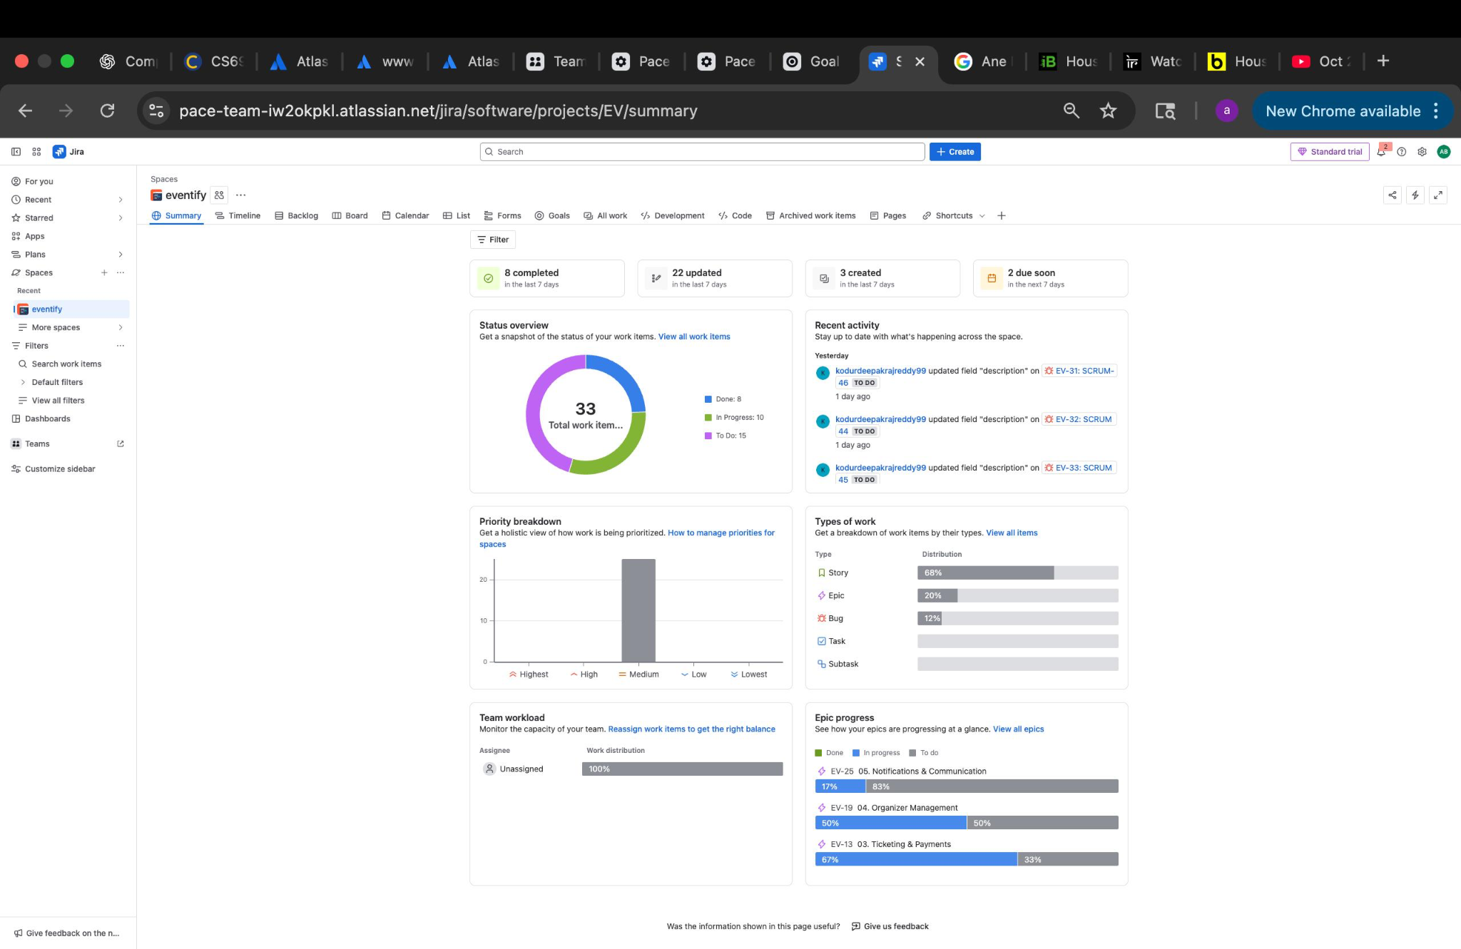
Project Overview & Metrics
KEY METRICS:
• 8 Items Completed (Last 7 Days)
• 22 Items Updated
• 3 New Items Created
• 2 Items Due Soon
STATUS BREAKDOWN:
33 Total Work Items
✓ 8 Done (24%)
⟳ 10 In Progress (30%)
⊘ 15 To Do (46%)
CURRENT PROGRESS: Sprint 2 Active

Slide 3
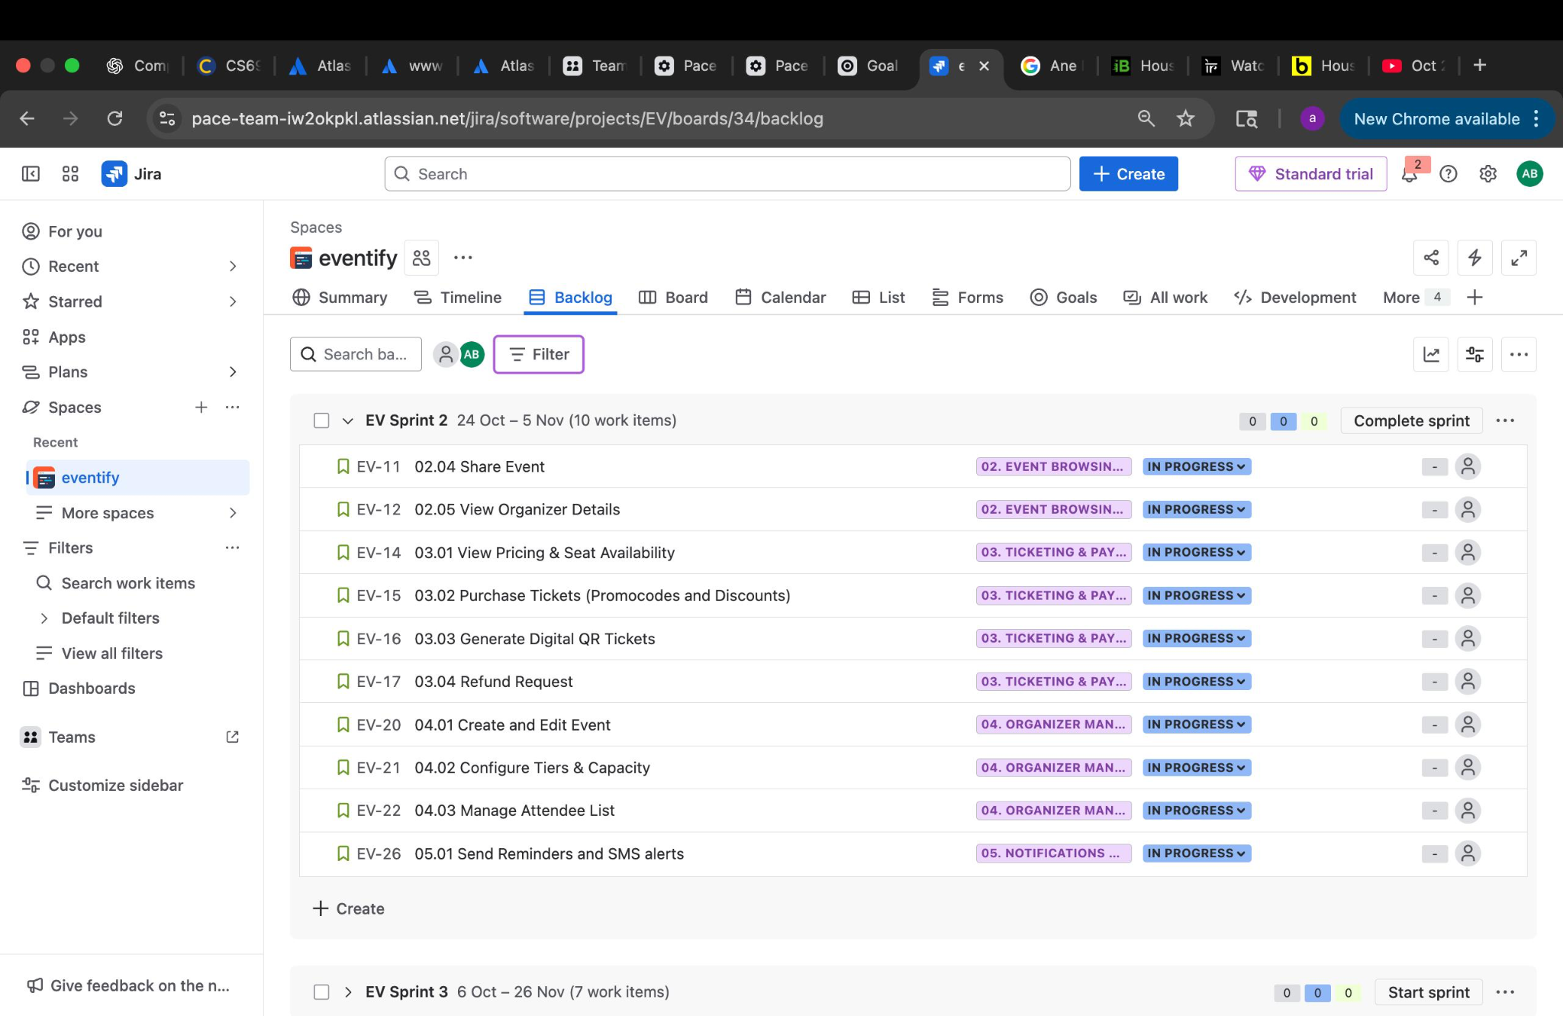
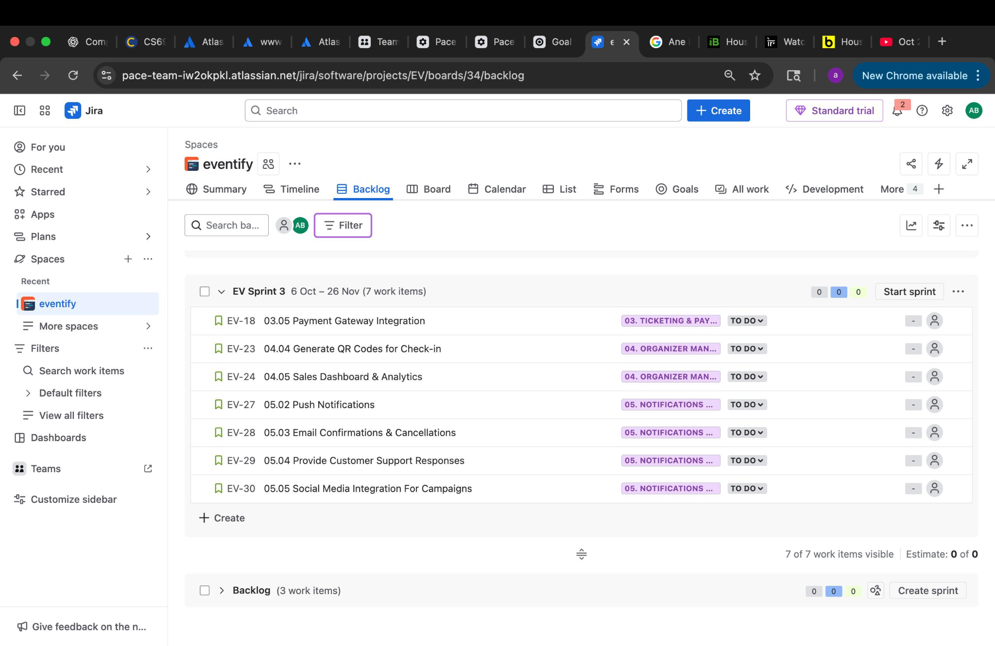
Sprint 1
Status: completed | 10 Work Items
SPRINT 1 FOCUS AREAS:
• Account Management
- User registration & authentication
- Profile management
PROGRESS: Foundation features for MVP

Slide 4
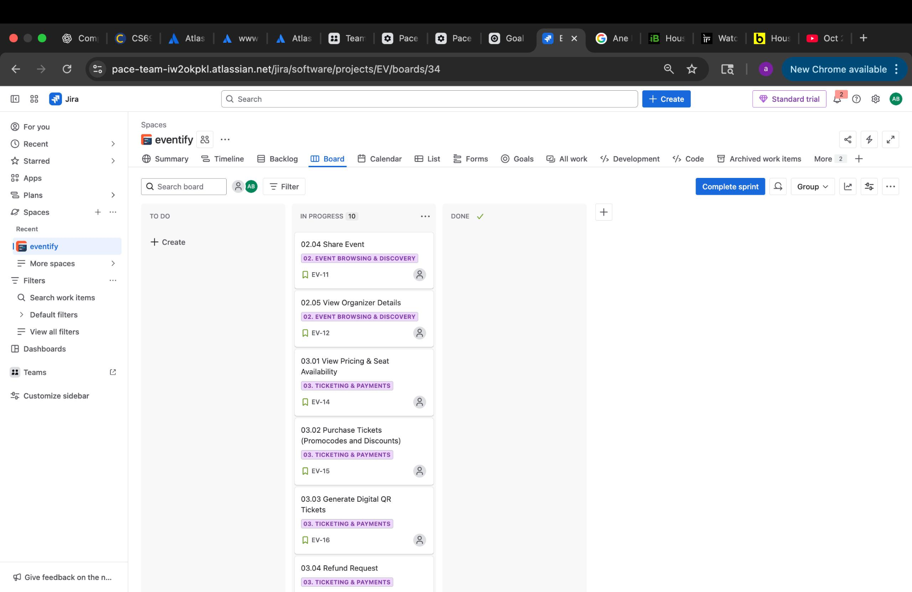
Board View - Workflow Status
User Registration & Login
• Event Search & Browse
• Event Details Page
• Share Events
• View Event Pricing
• Ticket Purchase Flow
• QR Code Generation
• User Profile Management
• + More foundational features

Slide 5
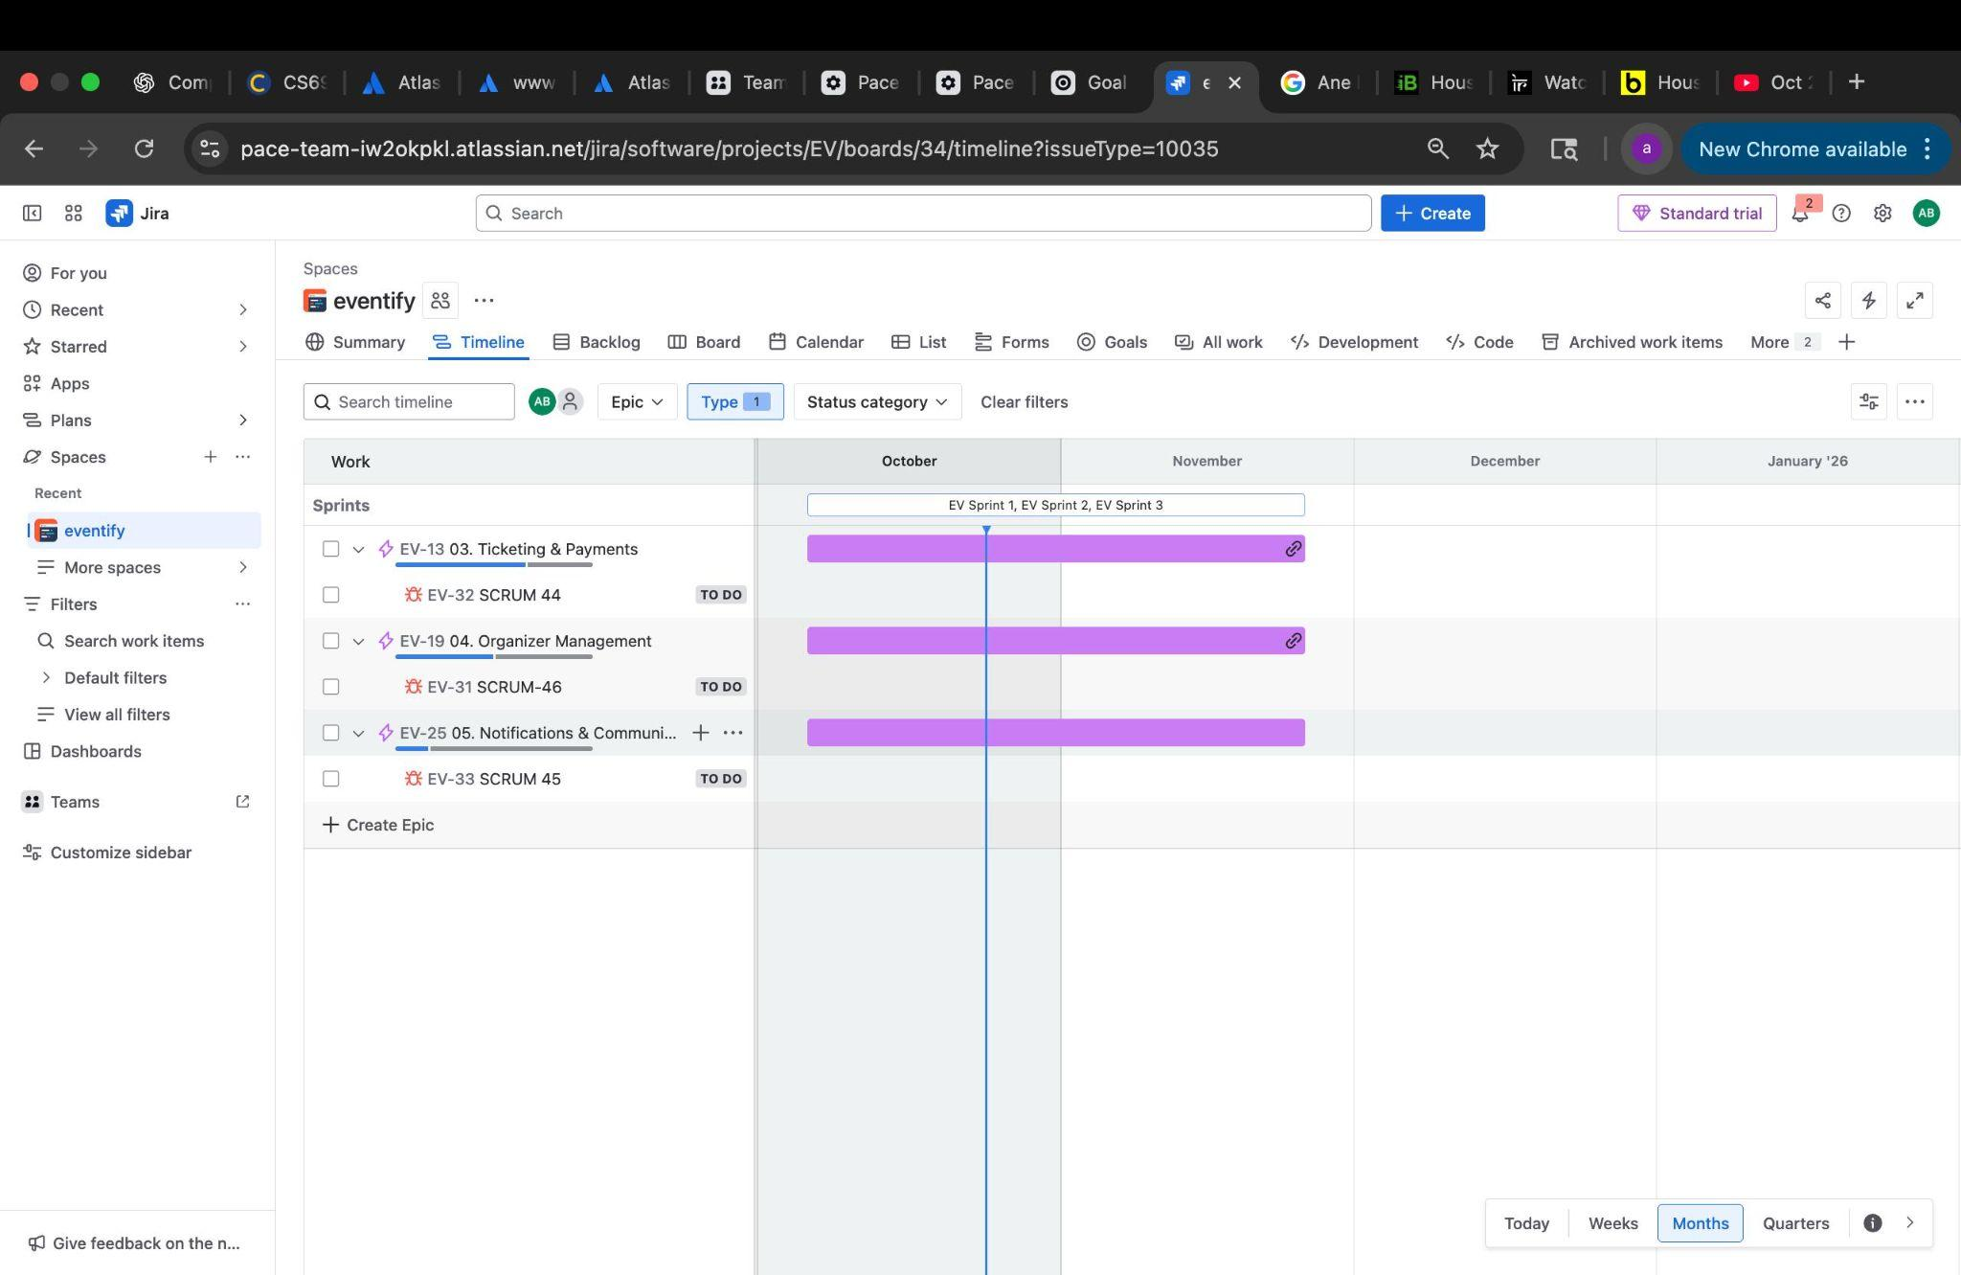
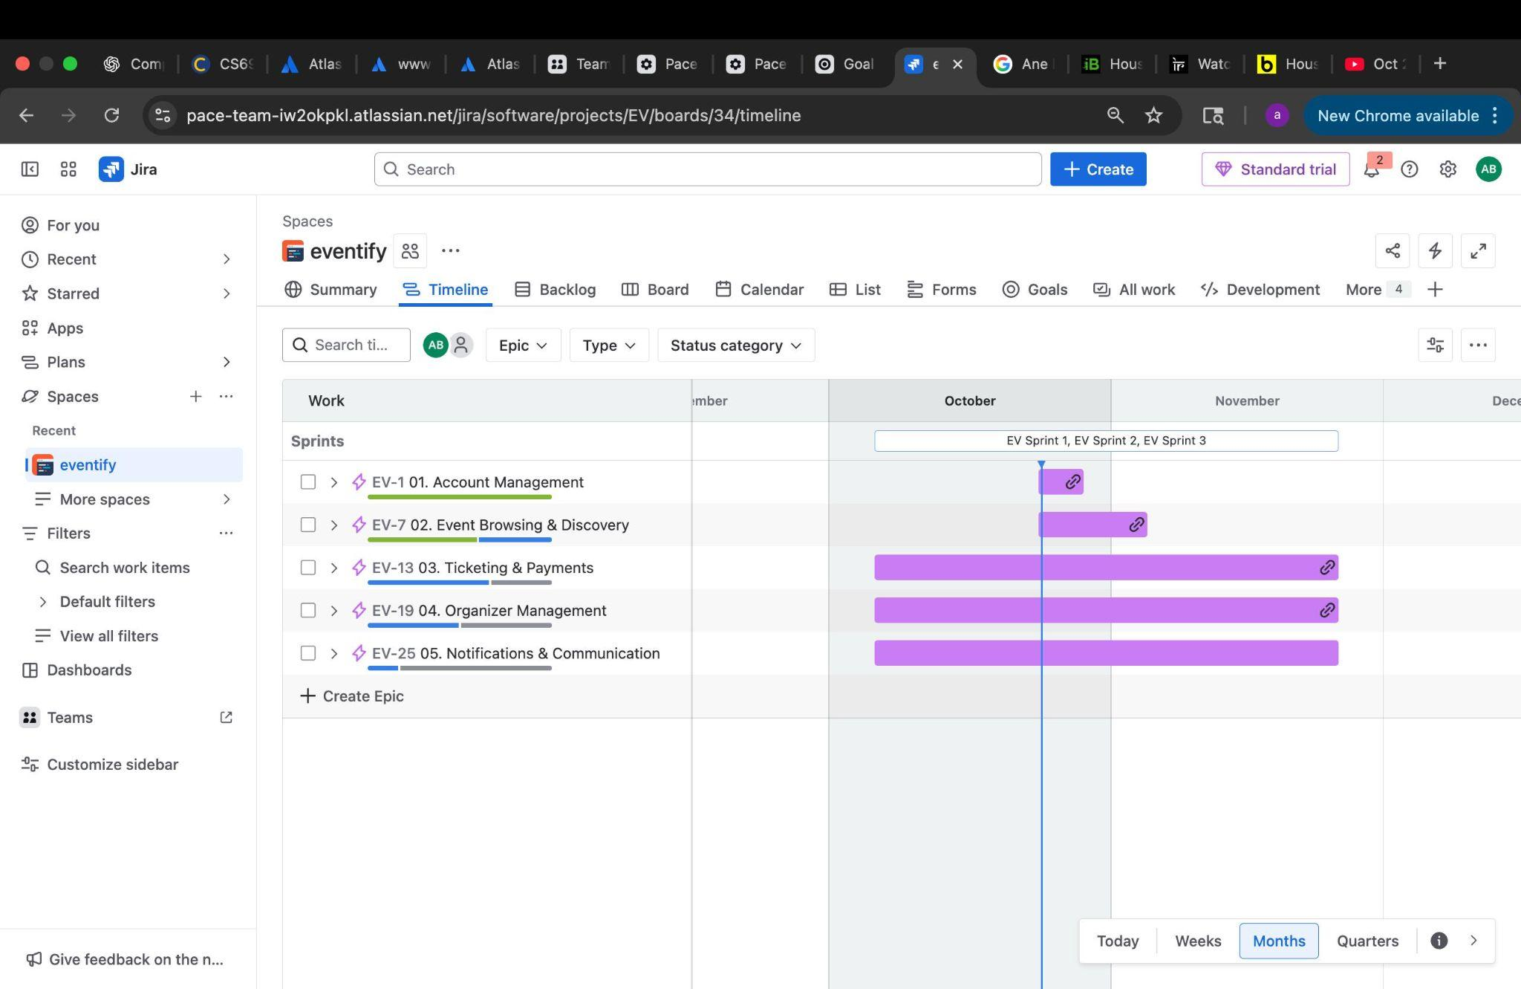
Epic Timeline & Roadmap
TIMELINE: October 2025 - December 2025
SPRINT 1 EPIC FOCUS:
1. Account Management (EV-1) █████ Completed
2. Event Browsing & Discovery (EV-7) ████░░░ In Progress
3. Ticketing Foundation (EV-13) ████░░░ Starting
UPCOMING EPICS:
4. Organizer Management (EV-19) - Sprint 2
5. Notifications (EV-25) - Sprint 2
MILESTONES:
• Complete user authentication
• Launch event discovery features
• Basic ticketing system operational

